Slide 1
Week#01
Data Structures
CS2001
Email: rafia.shaikh@nu.edu.pk

Slide 2
ADT - Abstract Data Types
Data types such as int, float, double, long, etc. are considered to be in-built data types and we can perform basic operations with them such as +,-,*,/, etc.
We can create data structures along with their operations, and such data structures that are not in-built are known as Abstract Data Type (ADT).
Abstract Data type (ADT) is a type (or class) for objects whose behavior is defined by a set of values and a set of operations.
The definition of ADT only mentions what operations are to be performed but not how these operations will be implemented.

Slide 3
ADT - Abstract Data Types
The implementation decides which data structure should be used to make execution most efficient in terms of time and space. An item specified in terms of operations is called an abstract data type
An abstract data type is not a part of a program, because a program written in a programming language requires the definition of a data structure, not just the operations on the data structure. However, an object-oriented language (OOL) such as C++ has a direct link to abstract data types by implementing them as a class

Slide 4
Some common ADTs
Stack
Operations: push, pop, top, isEmpty, size
Principle: Last-In-First-Out (LIFO)
Queue
Operations: enqueue, dequeue, front, isEmpty, size
Principle: First-In-First-Out (FIFO)
Linked List
Operations: insertAtBeginning, insertAtEnd, delete, search, display
Types: Singly Linked List, Doubly Linked List, Circular Linked List

Slide 5
Pointers
Variables that content the location of another variable are called pointers.
Pointers are usually auxiliary variables that allow us to access the values of other variables indirectly.
A pointer is analogous to a road sign that leads us to a certain location or to a slip of paper on which an address has been jotted down.
pointers—like all variables—also have two attributes: a content and a location.
This location can be stored in another variable, which then becomes a pointer to a pointer
int i=15, *p;
p=&I;
int *pp=&p;

Slide 6
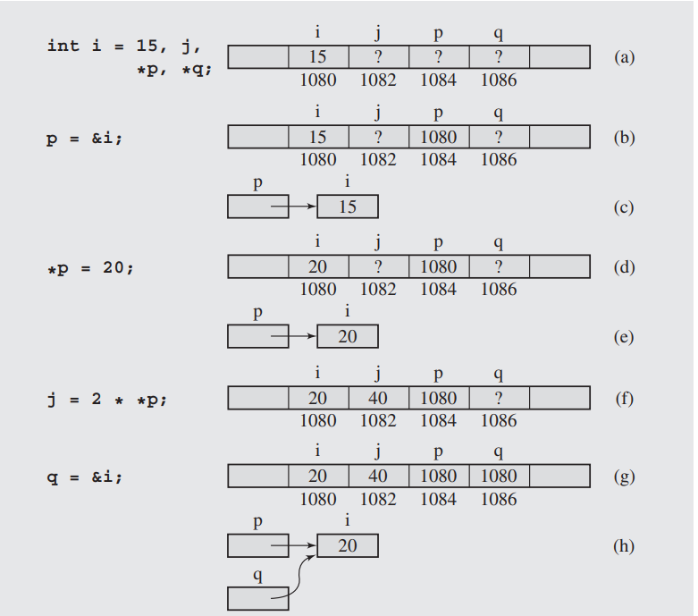
Figure 1.1 Changes of values after assignments are made using pointer variables. Note that (b) and (c) show the same situation, and so do (d) and (e), (g) and (h), (i) and (j), (k) and (l), and (m) and (n).

Slide 7
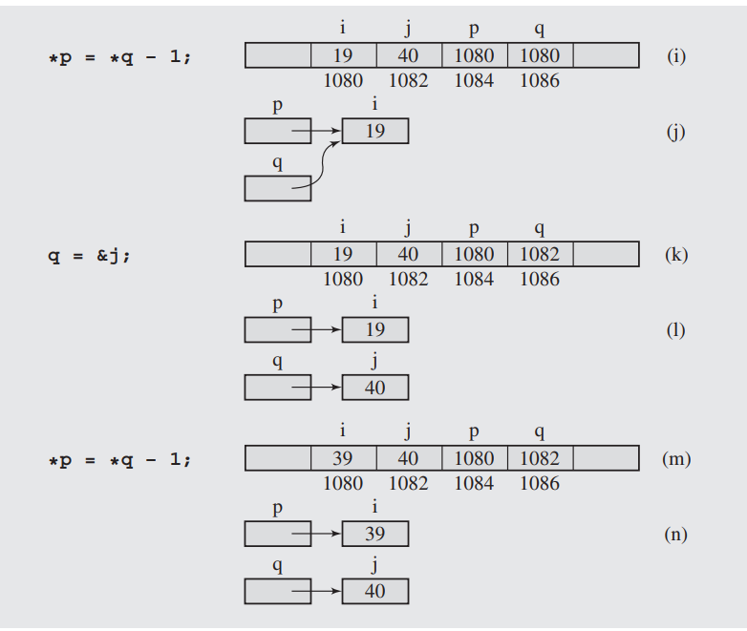

Slide 8
Dynamically allocate and deallocate memory
which is performed dynamically during the run of the program, unlike for variables, whose locations are allocated at compilation time.
To dynamically allocate and deallocate memory, two functions are used. One function, new, takes from memory as much space as needed to store an object whose type follows new.
For example, with the instruction
p = new int; // dynamically allocate memory
If the space occupied by the integer accessible from p is no longer needed, it can be returned to the pool of free memory locations managed by the operating system by issuing the instruction
delete p; // deallocate memory

Slide 9
Memory Leak
p = new int;
p = new int;
The code should be:
p = new int;
delete p;
p = new int;
Memory leaks can become a serious problem when a program uses more and more memory without releasing it, eventually exhausting memory and leading to abnormal termination.
Notes:
p = new int;
p = new int;
After allocating one cell for an integer, the same pointer p is used to allocate another cell. After the second assignment, the first cell becomes inaccessible and also unavailable for subsequent memory allocations for the duration of the program. The problem is with not releasing with delete the memory accessible from p before the second assignment is made. The code should be:
p = new int;
delete p;
p = new int;
Memory leaks can become a serious problem when a program uses more and more memory without releasing it, eventually exhausting memory and leading to abnormal termination. This is especially important in programs that are executed for a long time, such as programs in servers

Slide 10
Pointers and Arrays
In the previous slides, the pointer p refers to a block of memory that holds one integer.
A more interesting situation is when a pointer refers to a data structure that is created and modified dynamically.
This is a situation where we would need to overcome the restrictions imposed by arrays.
Arrays in C++, and in most programming languages, have to be declared in advance; therefore, their sizes have to be known before the program starts.
The problem is solved with the use of pointers.
Notes:
This means that the programmer needs a fair knowledge of the problem being programmed to choose the right size for the array. If the size is too big, then the array unnecessarily occupies memory space, which is basically wasted. If the size is too small, the array can overflow with data and the program will abort. Sometimes the size of the array simply cannot be predicted; therefore, the decision is delayed until run time, and then enough memory is allocated to hold the array. The problem is solved with the use of pointers

Slide 11
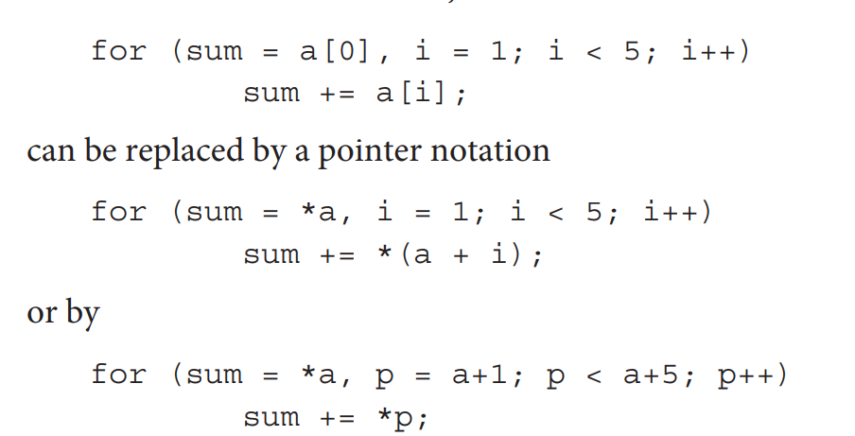
Pointers and Arrays
memory address c+i*sizeof(long).
Notes:
Note that a+1 is a location of the next cell of the array a so that a+1 is equivalent to &a[1].
Thus, if a equals 1020, then a+1 is not 1021 but 1022 because pointer arithmetic depends on the type of pointed entity.
For example, after declarations
char b[5];
long c[5];
and assuming that b equals 1050 and c equals 1055, b+1 equals 1051 because one character occupies 1 byte, and c+1 equals 1059 because one long number occupies 4 bytes.
The reason for these results of pointer arithmetic is that the expression c+i denotes the memory address c+i*sizeof(long).

Slide 12
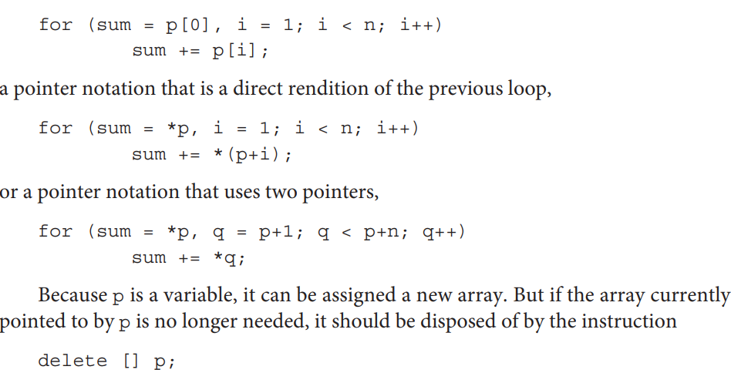
Arrays declared dynamically
p = new int[n];
. For example, the sum of numbers in the array p can be found with the code that uses array notation

Slide 13
Arrays declared dynamically
delete [] p;
Note the use of empty brackets in the instruction. The brackets indicate that p points to an array. Also, delete should be used with pointers that were assigned a value with new. For this reason, the two following applications of delete are very likely to lead to a program crash:
int a[10], *p = a;
delete [] p;
int n = 10, *q = &n;
delete q;
Notes:
delete and delete[] are intended to free memory that was dynamically allocated using new or new[].Using delete on memory that was not dynamically allocated (like stack-allocated arrays or variables) leads to undefined behavior, which often results in a program crash. The crash happens because delete tries to free memory that it shouldn't, leading to corruption of the program's memory management system.

Slide 14
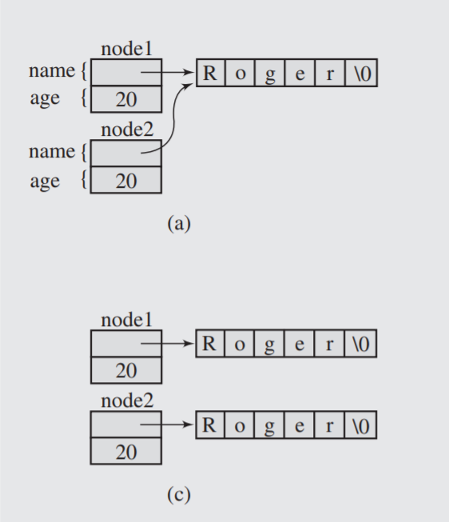
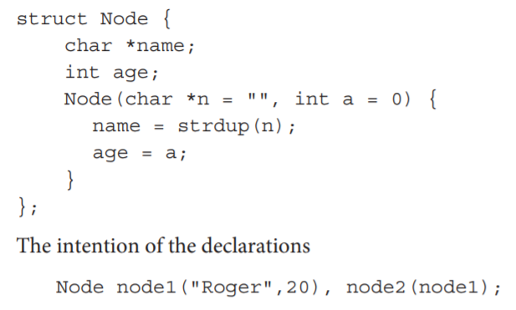
Pointers and Copy Constructors
Figure 1.2 Illustrating the necessity of using a copy constructor for objects with pointer members.

Slide 15
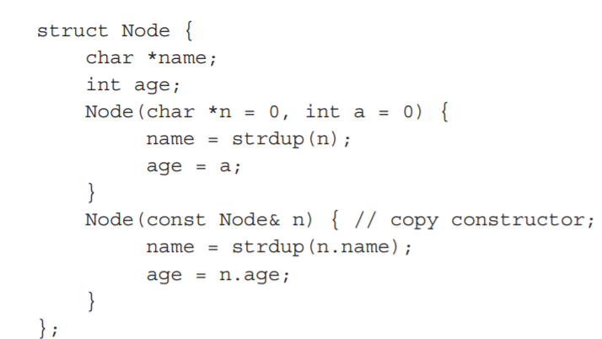
Pointers and Copy Constructors
Figure 1.2 Illustrating the necessity of using a copy constructor for objects with pointer members.

Slide 16
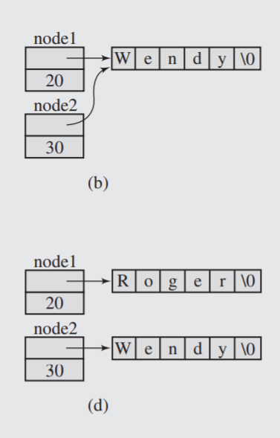
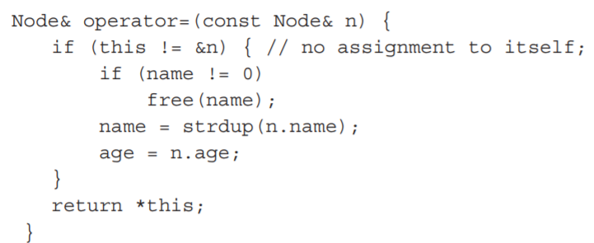
Pointers and Copy Constructors
Figure 1.2 Illustrating the necessity of using a copy constructor for objects with pointer members.
node1 = node2;

Slide 17
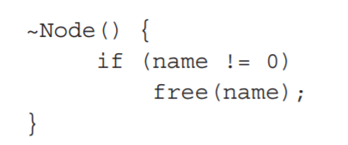
Pointers and Destructors
When a local object of type Node is destroyed, the memory occupied by the object itself is automatically released. This means the space allocated for its data members is freed.
However, if one of the data members is a pointer that points to dynamically allocated memory (e.g., a string allocated with malloc, new, or strdup), that memory is not automatically freed when the object is destroyed.
When Node object has a pointer name that points to a dynamically allocated string, destroying the Node object only frees the memory used by the name pointer itself, not the memory allocated for the string it points to.
As a result, the memory occupied by the string remains allocated but becomes inaccessible (a memory leak), because there’s no longer a pointer referencing that memory. This leads to a situation where memory is wasted and cannot be reclaimed until the program ends.
To avoid this problem, a destructor should be defined in the Node class. The destructor is a special member function that is automatically called when an object is destroyed.
The destructor's job is to clean up any resources that the object was using, such as dynamically allocated memory.

Slide 18
Code example!
https://docs.google.com/document/d/1b24WWF-1UcGD5y4IK1cHXCG9UOSyL8jlBi9n3ieOQlU/edit?usp=sharing

Slide 19
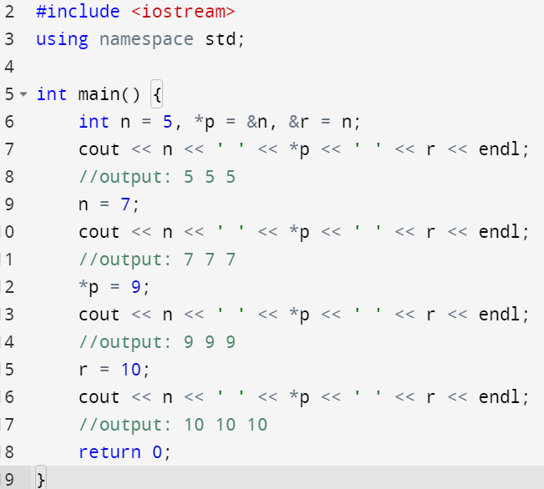
Pointers and Reference Variables
A reference variable must be initialized in its declaration as a reference to a particular variable, and this reference cannot be changed. This means that a reference variable cannot be null. A reference variable r can be considered a different name for a variable n so that if n changes then r changes as well. This is because a reference variable is implemented as a constant pointer to the variable.

Slide 20
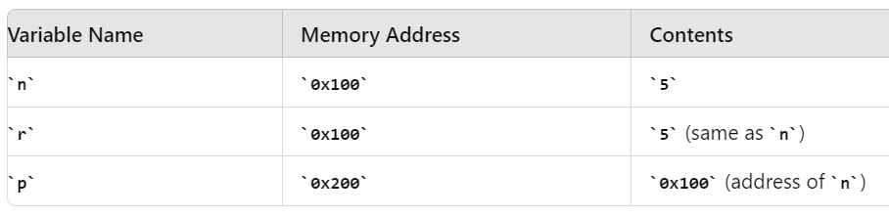
int n = 5, *p = &n, &r = n;

Slide 21
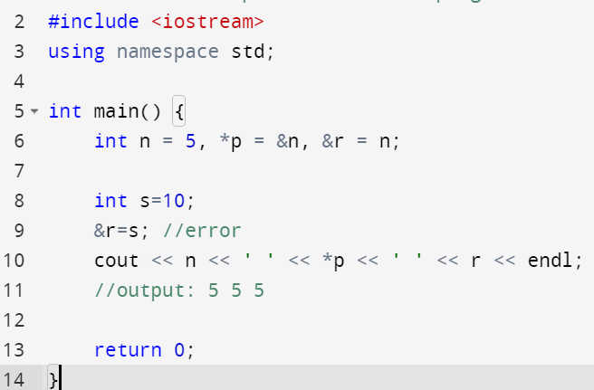
Reference variable
By design, references are meant to be immutable in terms of which variable they refer to, providing a clear and consistent way to alias variables in C++.

Slide 22
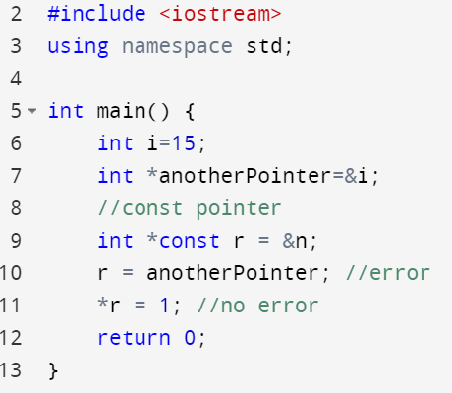
Constant Pointer (int *const)
A constant pointer is a pointer whose address (the value it holds) cannot be changed after initialization.
Must be initialized at the time of declaration.
You cannot change the address that a constant pointer points to, but you can modify the value at that address if the value itself is not constant.

Slide 23
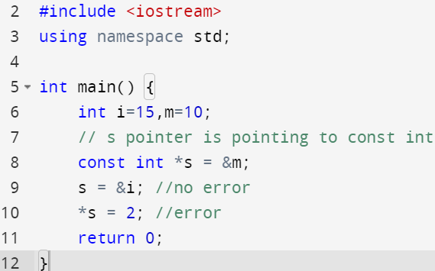
Pointer to Constant (const int *)
A pointer to a constant integer is a pointer that points to a constant value, meaning you cannot change the value at the address it points to.
You can change the address stored in the pointer, but you cannot modify the value at the address.

Slide 24
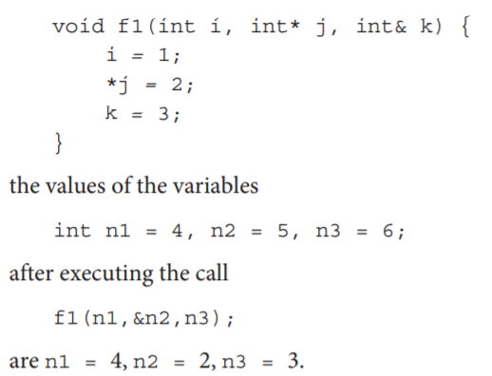
Passing arguments by reference to function calls
Reference variables are used in passing arguments by reference to function calls. Passing by reference is required if an actual parameter should be changed permanently during execution of a function. This can be accomplished with pointers

Slide 25
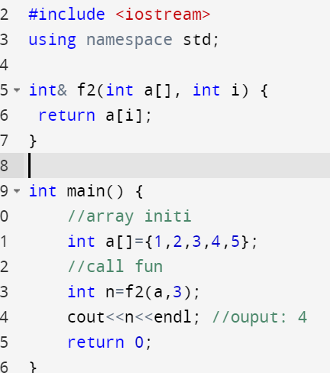
Pointers and Reference Variables
Reference type is also used in indicating the return type of functions. For example, having defined the function

Slide 26
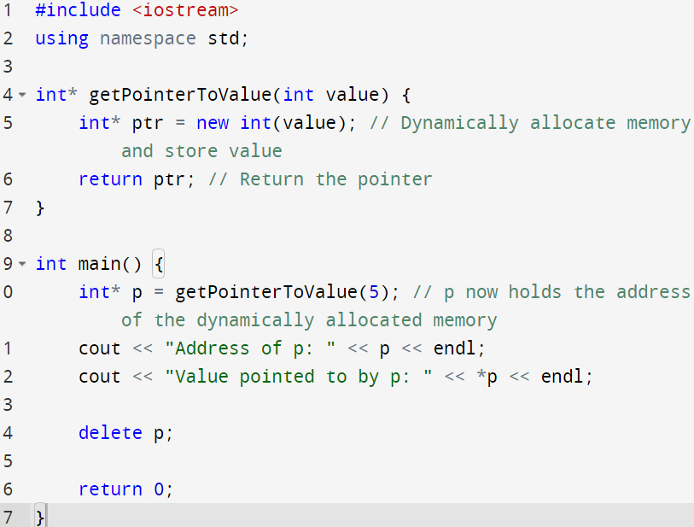
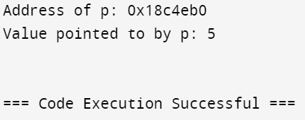
Pointer as Return type
Note that we can accomplish the same with pointers, but dereferencing has to be used explicitly:

Slide 27
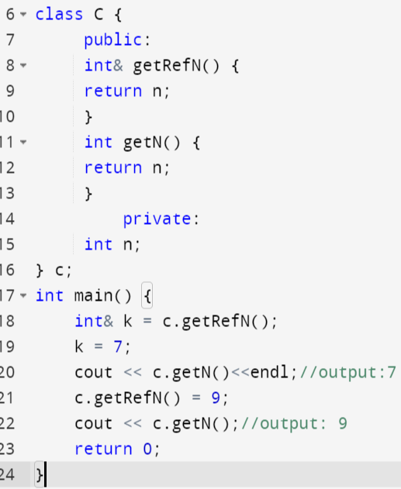
Caution!!
Reference variables and the reference return type have to be used with caution because there is a possibility of compromising the information-hiding principle when they are used improperly. Consider class C:

Slide 28
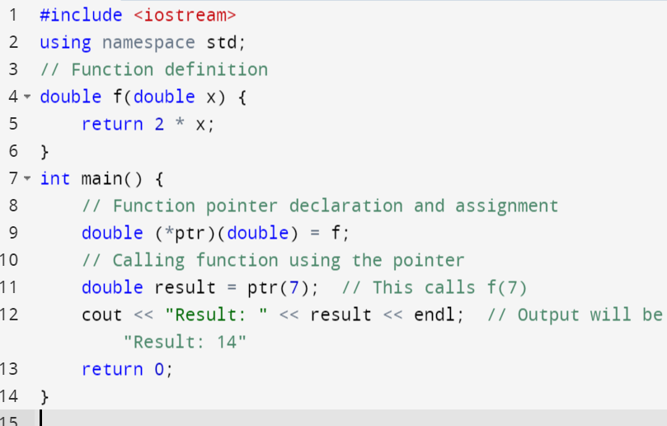
Pointers to Functions
Just like pointers to variables, you can have pointers to functions. A pointer to a function stores the address where the function's code is located in memory.

Slide 29
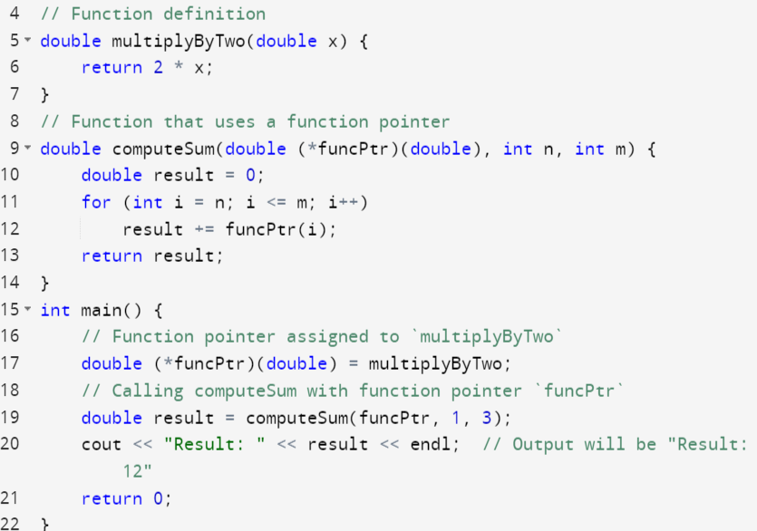

Slide 30
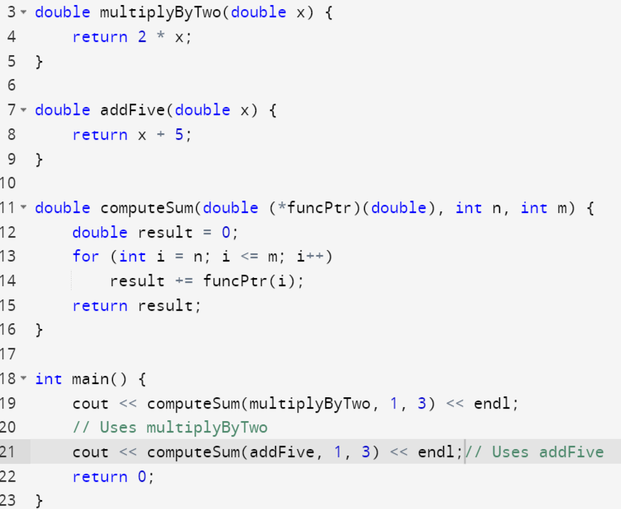

Slide 31
The Rule of Three in C++
If a class requires a custom implementation for any one of the following, it should implement all three.
Functions Involved:
Destructor
Copy Constructor
Copy Assignment Operator
Why Apply the Rule of Three?
Prevent Resource Leaks: Ensures proper cleanup of resources.
Avoid Double Deletion: Prevents issues from multiple deletions of the same resource.
Ensure Deep Copying: Properly copies dynamically allocated resources.
code example : https://docs.google.com/document/d/1uoNqkw4LGdppPkPaAqxukSfseipahaZZTPewSYQ4gjk/edit?usp=sharing

Slide 32
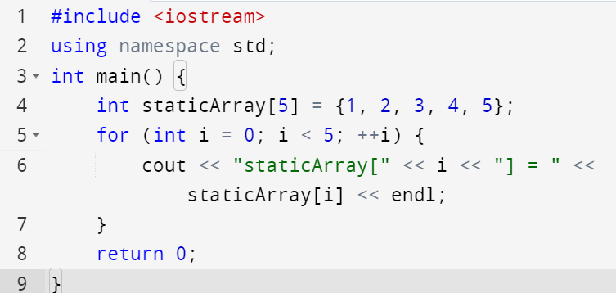
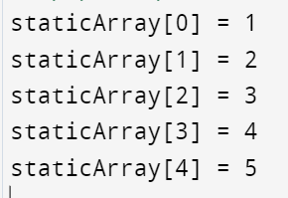
Static Array
Static arrays are arrays whose size is fixed at compile time and cannot be changed during runtime. The memory for static arrays is allocated on the stack, and their lifetime is limited to the scope in which they are defined.

Slide 33
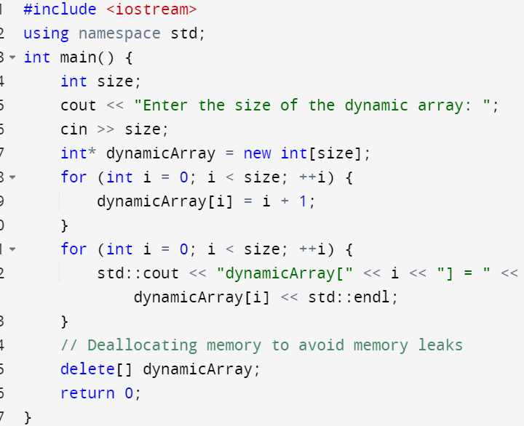
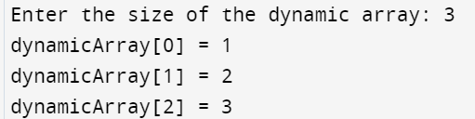
Dynamic Array
Dynamic arrays are arrays whose size is determined at runtime. They are allocated on the heap, allowing for flexible size adjustments during the program's execution. To use dynamic arrays in C++, you often use pointers and dynamic memory allocation functions.

Slide 34
Dynamic Array
A Dynamic array (vector in C++) automatically grows when we try to make an insertion and there is no more space left for the new item.
Approach:
Doubles the array size (or to a specified new size) when the array is full.
Reduces the array size when elements are removed.
Adds an element to the end of the array.
Adds an element at a specific position.
Removes the last element and optionally shrinks the array.
Removes an element at a given index.

Slide 35
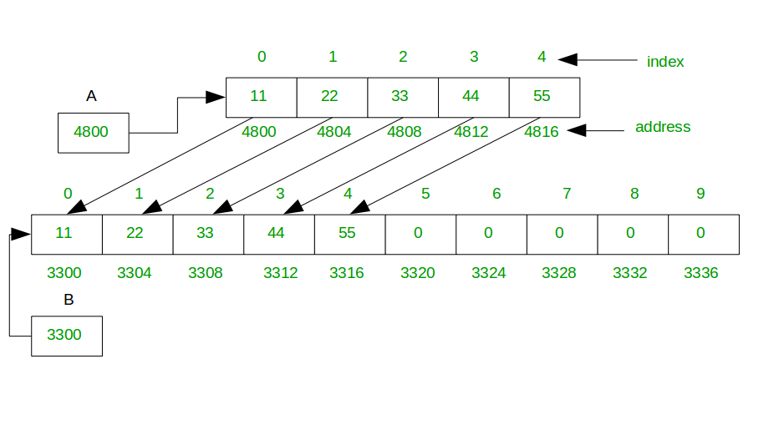
Dynamic Array

Slide 36
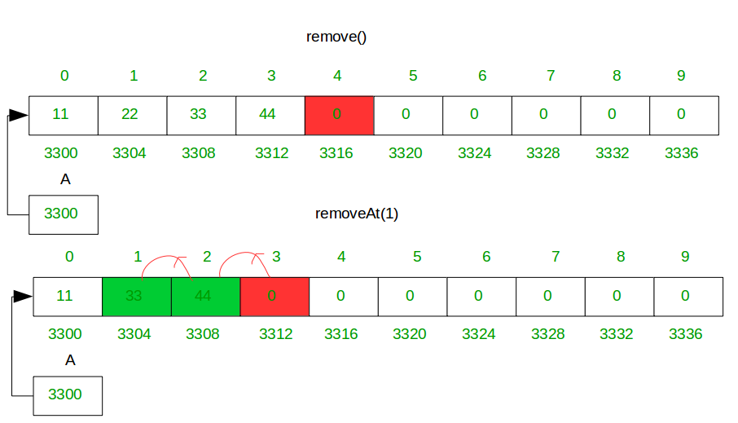
Dynamic Array

Slide 37
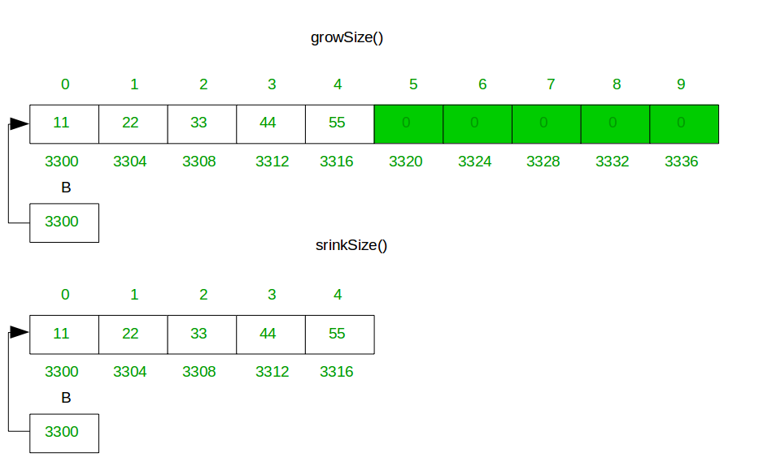
Dynamic Array

Slide 38
Dynamic Safe Array
Code: https://docs.google.com/document/d/1MyP4PLHr9AnPuS7iTPGAtE0FWw6vbxUeZQnwEHOdnmU/edit?usp=sharing

Slide 39
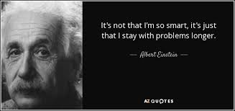
The Power of Persistence
This highlights the main takeaway from Einstein's quote, focusing on the importance of staying dedicated to problem-solving.

